Slide 1

Design and Development of a Virtual Reality System to support Reminiscence Therapy for Patients with Dementia
Abdurrahman Ansari, 100585644
Dhanushga Lionel, 100616831
Mohammed Hameeduddin, 100587893
Mingwei Zhang, 100519827

Slide 2
Objectives and Goals
Allow easy access to reminiscence therapy media through an intuitive web interface.
Allow staff to access profiles of every patient as well as general profiles.
Allow caregivers to access media associated with a specific profile.
Allow users to view and stream images, videos, and audio files.
Allow streaming of media to one of many available streaming devices.

Slide 3
Project Stakeholders
Ontario Shores Centre for Mental Health Sciences (primary stakeholders)
Ontario Tech University
Ontario Tech University - Faculty of Health Sciences
Dr. Ramiro Liscano

Slide 4
Hardware Implementation
Existing Solutions:
Google Chromecast for streaming
Pros: Commercial off-the-shelf solution, easy maintenance, easily available support, has been rigorously tested by multiple consumers and professionals.
Cons: Security, not customizable
Custom Solutions:
Proprietary streaming device
Pros: Customizable to suit our needs
Cons: Support not always readily available, maintenance up to developers (no easily available resources)

Slide 5
Software Implementation
Full Stack Web Application
HTML/CSS - Front end
PHP - Server side
MySQL - Database

Slide 6
Design Analysis

Slide 7
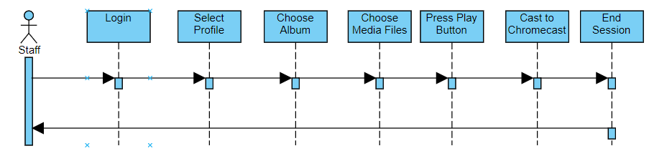
Sequence Diagram - Play Media Files

Slide 8
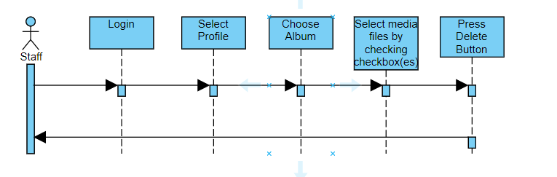
Sequence Diagram - Delete Album

Slide 9
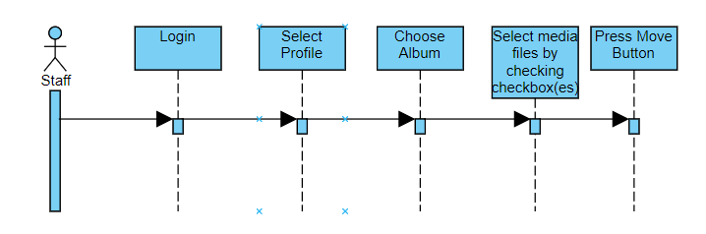
Sequence Diagram - Move Album

Slide 10
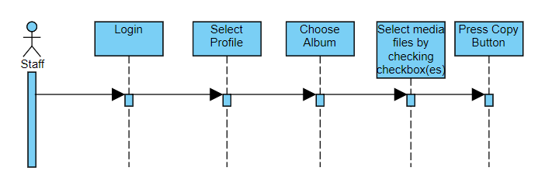
Sequence Diagram - Copy Album

Slide 11
Novelty Factor
Why not use Google photos or something similar?
Ease of use - Primary stakeholder requirement
Administrator Full Control
Different Roles
Patient Data Storage Restrictions

Slide 12
Demo

Slide 13
Q&A

